Slide 1


CO458 – XML Introduction to Extensible Markup Language

Slide 2
Module Schedule
Wk. | Lecture/subject area(s) | Practical | Reading (McGrath, 2007; Moseley, 2007)
1 | Introduction to XML | XML exercises | Mosely Ch 8.
2 | XSL, XSLT – quick start | XSL and XSLT exercises | Mosely Ch 9.
3 | Web services, RSS, Blogs | Continue ‘quick start’ exercises | Mosely Ch 10.
4 | XML documents – 1 | Designing and writing XML documents | McGrath Ch 1.
5 | XML documents – 2 | Designing and writing XML documents | McGrath Ch 1.
6 | XSD schemas –1 | Designing schemas and schema validation | McGrath Ch 3.
7 | XSD schemas – 2 | Designing schemas and schema validation | McGrath Ch 3.
8 | XSD schema restriction | Imposing fine restriction controls | McGrath Ch 4.
9 | XML namespaces | Using namespaces in XML | McGrath Ch 5.
10 | XSL stylesheets – 1 | Designing and applying stylesheets | McGrath Ch 6.
11 | XSL stylesheets – 2 | Designing and applying stylesheets | McGrath Ch 6.
12 | XPath expressions – 1 | Writing and using XPath for advanced element selection | McGrath Ch 7.
13 | XPath expressions – 2 | Writing and using XPath for advanced element selection | McGrath Ch 7.
14 | XPath expressions – 2 | Writing and using XPath for advanced element selection | McGrath Ch 7.

Slide 3
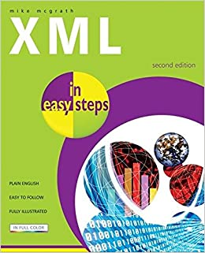
Resources
https://www.w3schools.com/xml/

Slide 4
XML
XML stands for eXtensible Markup Language.
XML was designed to store and transport data.
XML was designed to be both human- and machine-readable.
concerned with semantics (meaning) rather than format or presentation
is a mechanism for transferring/swapping data between dissimilar systems particularly involving sharing across applications over the Internet

Slide 5
What is the purpose of XML?
The primary use of XML is to describe data, including the structure of data – examples include: genealogical, scientific, business, legal, geographical, sociological …
XML ‘only’ describes data, it doesn’t process, transmit, present or perform any other action on data
XML allows data to be cleanly separated from data processing
In a Web context this means that XML can separate data from HTML presentation – changes to either XML should not effect the HTML (and vice versa)

Slide 6
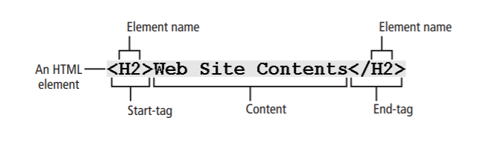
Remember HTML?
Each element begins with a start-tag: a block of text preceded with a left angle bracket () that contains the element name and possibly other information. Most elements end with an end-tag, which is like its corresponding start-tag except that it includes only a slash (/) character followed by the element name. The element’s content is the text—if any—between the start-tag and end-tag.

Slide 7
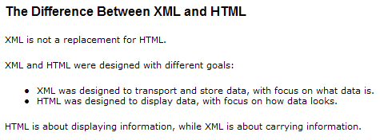
XML Structure
Elements
Must have a closing tag
Tags are case sensitive
Must be properly nested
Attributes
Values must always be in quotes
<employed startDate=“12/04/09”>Bucks New Uni</employed>
Other essentials
White-space is preserved in XML (HTML truncates multiple white-space to a single one)
Comments are identical to HTML format <!-- my comments -->

Slide 8
What does XML look like?
Self describing syntax – here an example for “persons”
<?xml version="1.0" encoding="UTF-8"?>
<person>
<first>Fred</first>
<last>Blogs</last>
<birthdate>20 March</birthdate>
<birthplace>Leeds</birthplace>
<employment started=“12/12/04”>Leeds City Library</employment>
</person>
Line 1 => the xml prolog with version, character encoding (UTF-8 is the default and the preferred encoding for e-mail and web pages)
Line 2 => obligatory single “root” element <person>
Lines 3-7 => nested elements with <person> data
Line 8 => close root element
All data is “self-describing” and readable by humans
Machines (browsers and applications) can also be instructed on how to read, process and/or present XML data

Slide 9
person
last
first
birthdate
birthplace
employment (started)

Slide 10
Examples of XML
SVG
SVG stands for Scalable Vector Graphics.
SVG defines vector-based graphics in XML format.
https://images.studee.com/images/university/university__bucks-new-university--logo.svg

Slide 11
Examples XML
SVG (Scalable Vector Graphics);
XHTML; RSS (Really Simple Syndication) “web feeds”;
MathML;
RDF (Resource Description Framework) – “RDF is a framework for describing resources on the web”;
WAP (Wireless Application Protocol) and WML (Wireless Markup Language);
GML (Geography Markup Language);
KML (Keyhole Markup Language)

Slide 12
Validating XML - DTDs and Schema
XML is primarily concerned that structure is well formed (nested tags, attributes in quotes etc.) and that syntax is valid for the context.
Document Type Definitions (DTDs) and XML schema provide two means of specifying a ‘legal’ structure for a document.
For example we could specify that a document of the type <memo> must contain four elements of <to>, <from>, <title> and <message>.
DTD format describes an XML document in terms of elements, tags, attributes, entities, PCDATA and CDATA - e.g. memo.dtd
<!ELEMENT memo (to, from, title, message)> “memo” defined as having 4 further elements
<!ELEMENT to (#PCDATA)> “to”, “from”, “title” and “message” are all defined
<!ELEMENT from (#PCDATA)> as having PCDATA (parsed character data). The
<!ELEMENT title (#PCDATA)> alternative is CDATA (comment data).
<!ELEMENT message (#PCDATA)>
An example of an XML document to be validated against the above …
<?xml version=“1.0”?>
<!DOCTYPE memo SYSTEM “memo.dtd”> Specifies the DTD against which the memo should be validated.
<memo> “memo” is a ‘complex’ element that contains other elements.
<to>Angus</to> “to”, “from”, “title” and “message” are ‘simple’ elements containing
<from>Liz</from> parsable data.
<title>Meeting</meeting>
<message>Don’t forget … </message>
<memo>
Can also specify number, type, order of elements as well as attributes (pp 172-5, Moseley, 2007)

Slide 13
XML Further Points
Specifying attributes in schema
Specified with a similar syntax
<firstName lang=“EN”>Roger</firstName> - XML
<xs:attribute name=“lang” type=“xs:string”/> - Schema spec’ of “lang”
Can also specify other attribute ‘attributes’ e.g. default=“EN”, use=“optional/required”
Well-formed?
XML documents should be well formed (nested, attribute values in quotes etc.) and valid (obey rules of any DTD or schema imposed)
An XML parser can check for “well-formedness” and validation.
Parsers include:
those built in to XML editors (Oxygen, XML Spy),
browsers with built-in parsers which can be accessed with JavaScript (e.g. IE 5.0+, Firefox and other browsers)
Programming/scripting languages/libraries (e.g. Java, .NET, JavaScript)

Slide 14
Using XML - Research /Consultancy at BNU
“A Workflow application and XML data-structure for processing geo-referenced images”
Funded by ACARP, Australia
Problem – monitor re-vegetation of open cast mining using complex image processing workflows. Workflows need to be repeatable, portable, use same data-structure for driving and reporting image-process workflows …
Seems like a job for a portable data structure – XML!
Solution - C # application with built in XML processing
Application will [1] create; [2] read, validate, check for well-formedness; [3] import; [4] execute; [5] generate XML reports from an XML Workflow document
create
read
validate
well-formed?
Execute image processing workflow from XML
Generate HTML reports from XML using XSL stylesheet transformations

Slide 15
Summary

Slide 16
Summary
XML is a markup language that was designed to describe, transport and store data.
In contrast HTML was designed to display data.
XML syntax is nearly identical to HTML using tag-pairs for elements which may contain attributes and other elements.
XML syntax is stricter than HTML, for example, requiring all elements to be properly nested (well-formed) and attribute values to be placed in quotations
Namespaces may be used to prevent conflicts between identical element names used in different contexts.
Document Type Definitions and XML Schema may be used to ensure that XML documents conform to (are valid with respect to) a data structure.
There are very many uses for XML and data may be treated, parsed, presented, manipulated in much the same way as data in databases or from other sources.
All browsers can transform XML data according specification in XML style sheet language.
Perhaps the three most important XML technologies to the Web developer or practitioner are: XML, XSD and XSL.
Next week … XSL and XSLT.

Slide 17
NEXT TIME
XSL and XSLT

